Slide 1
Exporting ODB++ with Allegro Guide
Sep 20, 2018
CONFIDENTIAL COMPANY INFORMATION

Slide 2
Agenda
This guide includes:
DFM issue with ODB++ exporting → Slide 3
The ODB++ Export Guide → Slide 4

Slide 3
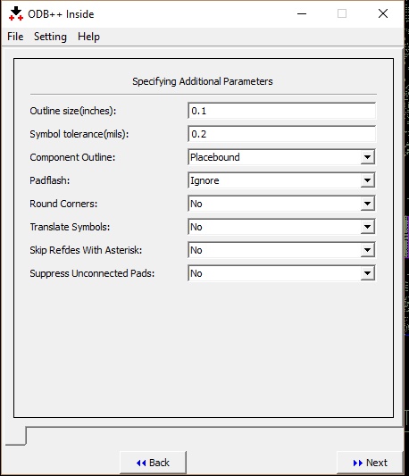
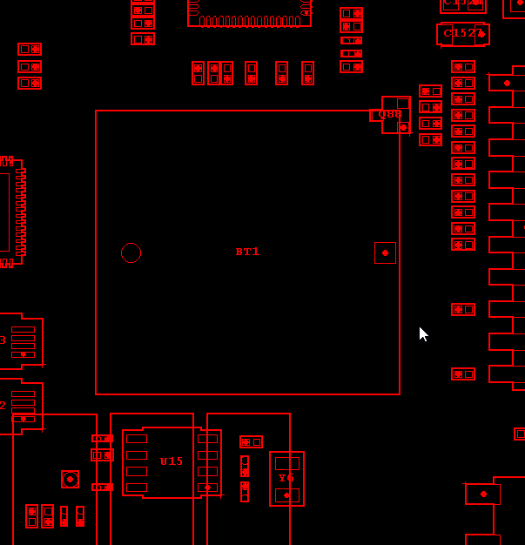
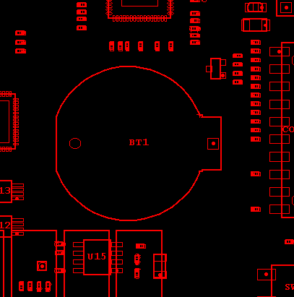
DFM issue
  When we export ODB++ on Allegro with Placebound option for Component Outline, DFM might meet an issue “component overlap component”. Therefore, we suggest to use Assembly for Component Outline. Please see the example:
Component Outline with Placebound
Component Outline with Assembly

Slide 4
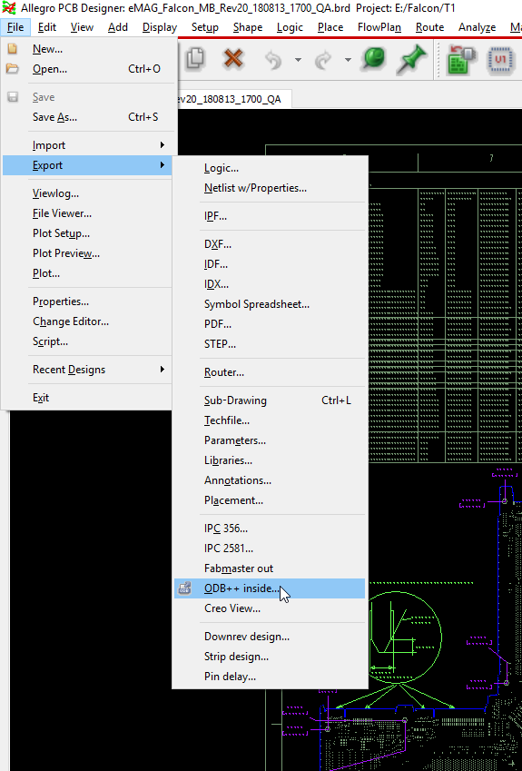
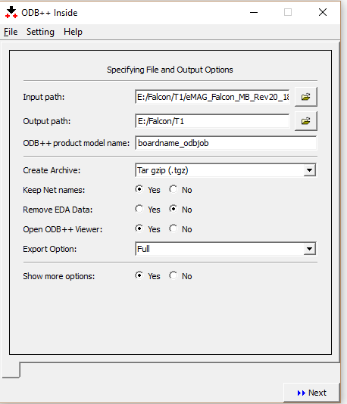
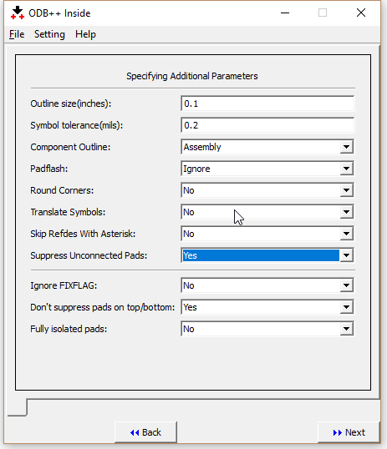
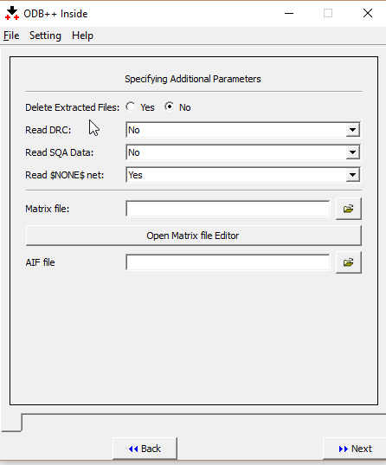
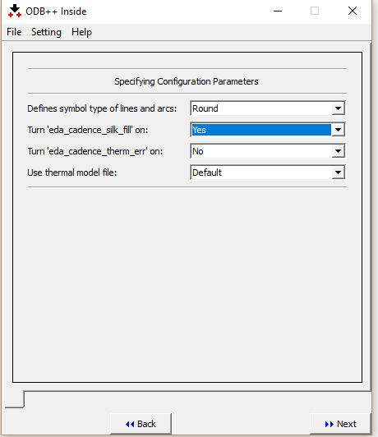
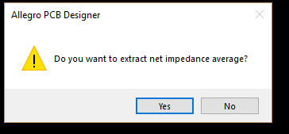
ODB++ Export Guide
Step2:
Should fill in BoardName_odbjob
Should chose .tgz option
Chose Full for Export option (Both FAB and Assembly house)
Chose Yes for show more option
Step3:
Chose Assembly for Component Outline
For suppress Unconnected pads board:
  Chose Yes for suppress Unconnected pads
  Chose Yes for Don’t suppress pads on top/bottom
Step4: All are default
Step5:
Chose Yes for turn “eda_cadence_silk_fill” on
We completed setting ODB++ export, please click Next to generate ODB file
Step1: Export ODB++

Slide 5
Thank You!

